Slide 1
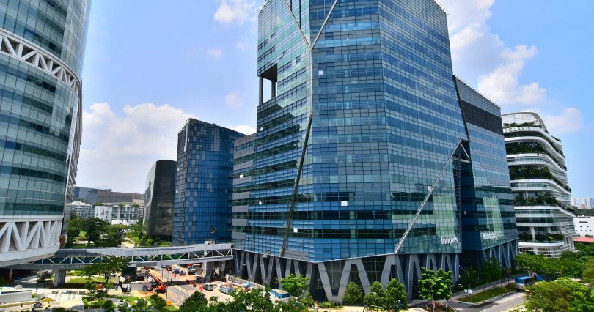


Understanding of EEG Signal variation over days and subjects for general classification purpose
Bharat Nagaraju -A0178258N
Chan Su-Wen Philemon - A0110588E
Vignesh ram andiappan selvaraj -A0178215A

Slide 2
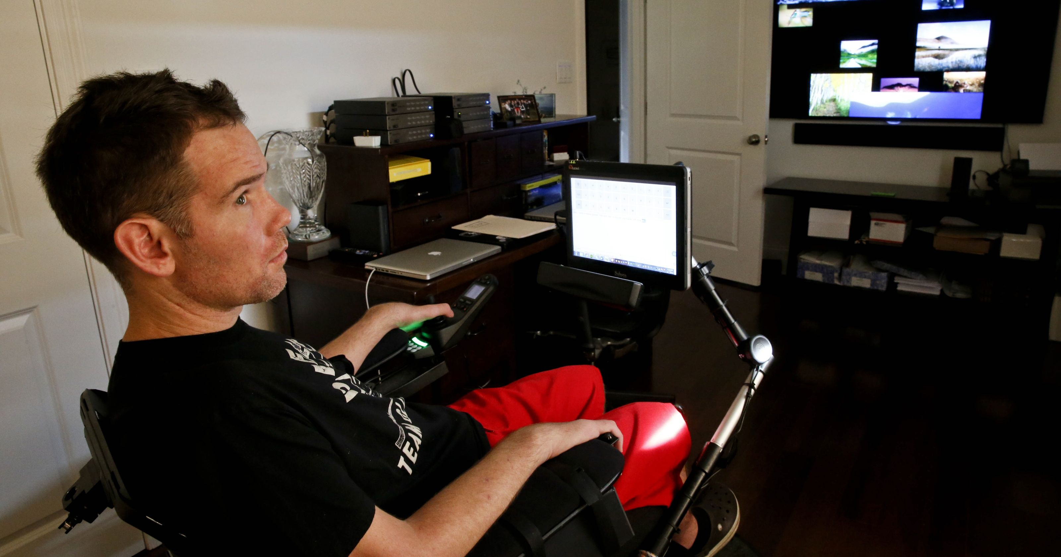
Problem Description
Help patients with neurological disabilities perform basic activities of daily life
Currently, there are no realistic, affordable or low-risk options
Machine Learning Algorithms for classifying different EEG signals produced by brain for different activities
Brain-computer interface (BCI) system to provide communication method for conveying brain messages
Figure 1: Patient with neurological disabilities

Slide 3
Challenges
Inconsistent EEG patterns due to a varying level of subject’s awareness and mental status.
Placement of electrodes (i.e. position on the subjects' scalp)
may vary from day to day and person to person.
Electrodes might short circuit each other.
eeg signals of ALS patient may be associated with the wrong movement imagined due to their inability to hear, see or react correctly.

Slide 4
Project Scope and Objectives
Decode electroencephalogram (EEG) signals
To develop a brain computer interface (BCI) system to aid patient’s mobility.
No Integration with any device
EEG signals are received and stored
Pre-processing, training and validation to build models to classify EEG
Build model to predict inter subject’s action (i.e. grasping or lifting using Open Source data)
Develop an Inter Subject EEG classification system for A*STAR
To aid future development of decoder for brain signals for patients with ALS

Slide 5
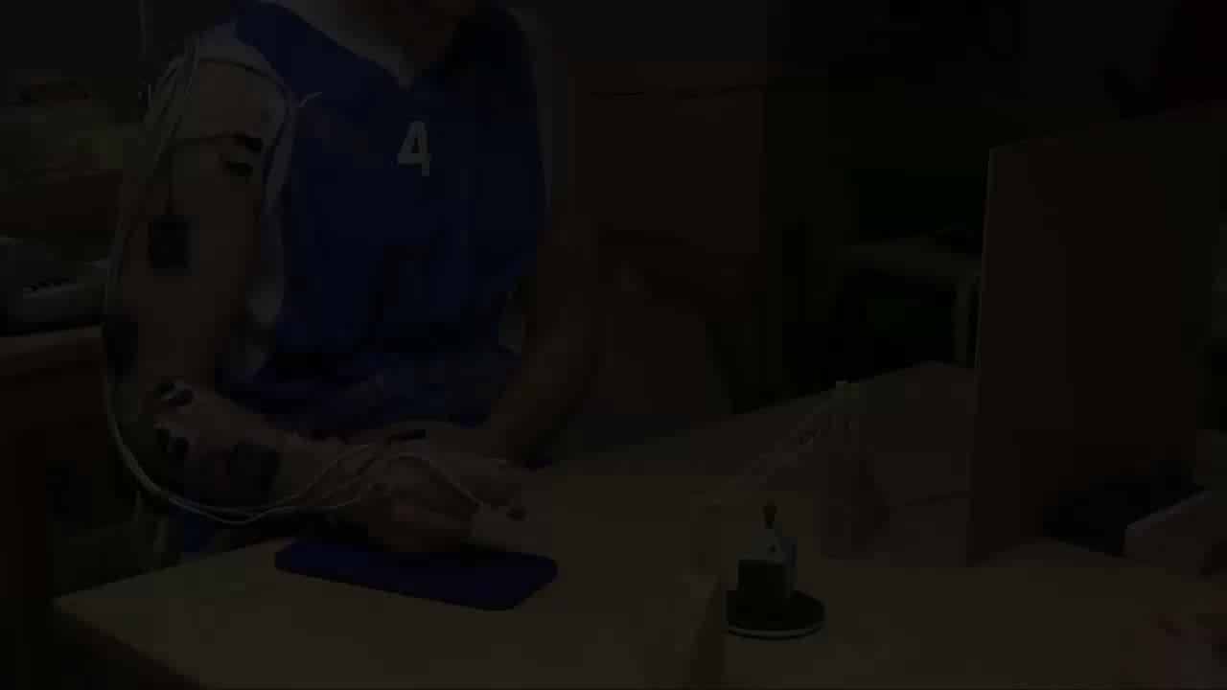
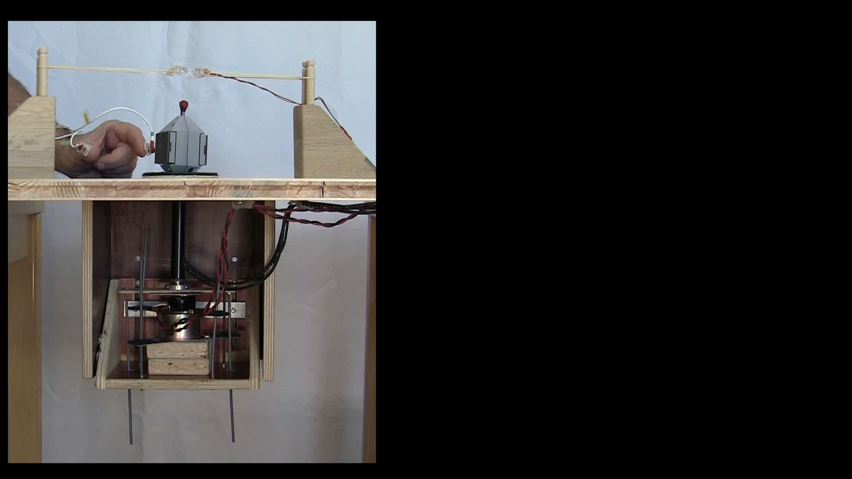
Experiment - Video
Grasp and Lift (GAL) experiment were carried out among healthy subjects
Conducted in the same order for all 12 subjects
Similar to A*STAR dataset, the signal data is stored and pre-processed before being used for Training and Validation of the intended models

Slide 6
Open Source - Solution Outline
Approach 1:
Build a CNN model that can classify various actions of the subject and ignore any variation in readings of the subject(s) (Open Source). Optimize the CNN model by tuning the hyper parameters.
Approach 2:
Build a CNN + LSTM Sequence model to overcome the limitations on CNN.
Validation Method:
Build a CNN + Capsnet Sequence model to overcome the limitations on CNN.

Slide 7
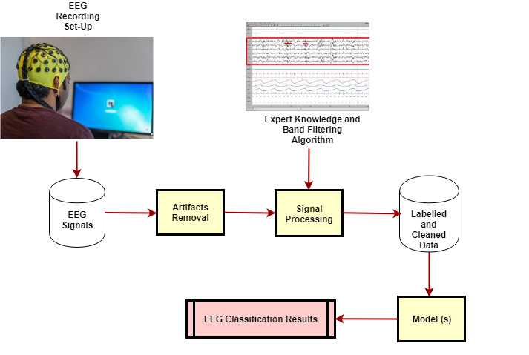
EEG Signal Processing and Model Data Workflow

Slide 8

Related Work (Open Source Dataset)
Various signal processing pipelines are utilized in experiments found in the literature, but the main stages are roughly the same. The transformations applied to the raw digital EEG signal can be divided into the following steps
Artifact rejection
Time-domain filtering
Class feature generation
Classification

Slide 9
Problem solving Paradigm – Healthy subjects
Try Different Methodologies (Open Source Dataset) :
1D - CNN
2D - CNN
LSTM + CNN (1D)
LSTM + CNN (1D) + Radam Optmizer
Reinforcement Learning
Capsule Network using 1D CNN [with reduced channels]
Capsule Network using 1D CNN
Capsule Network using 2D CNN

Slide 10
Technical Architecture and Design
Data Pre-Processing (Open Source Dataset)
Raw data is well structured and cleaned
Signals contain noise of varying frequency and should be pre-processed
Very high sampling frequency of the EEG compared to relatively low rate of change of the performed action can create issues
To process the data:
First step is to filter the data with a low-pass filter.
Next, Balance the data by subsampling (i.e. we can keep only one data point every 100,500, etc.)
Remove the singularity of the data (i.e. exclude bad trials by inspection and eliminate noise based on certain rules)

Slide 11
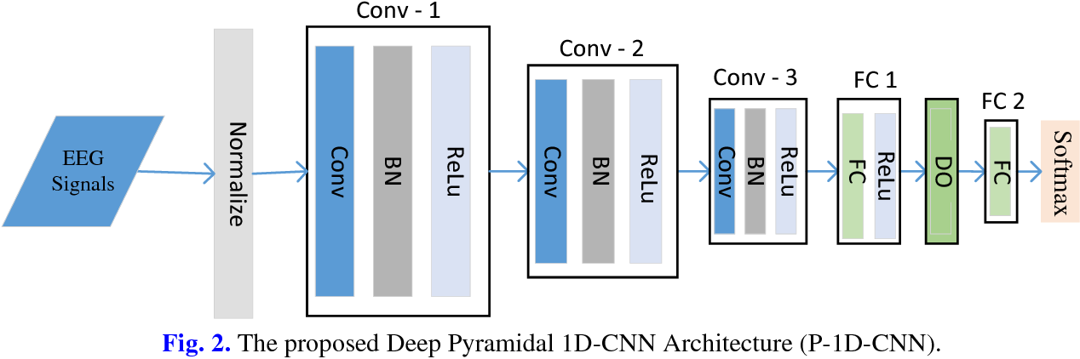
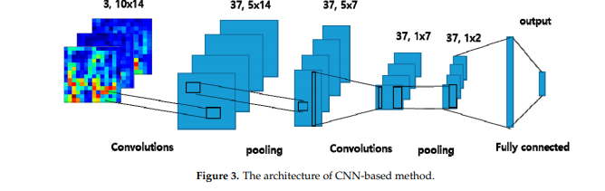
Technical Architecture and Design ( Open Source)
Baseline – Approach 1 - 1D CNN:
This baseline network can beat all the open source Kaggle kernels (Avg: 87+% AUC)
After Preprocessing, Three Convolutional layers are added
Network:
self.conv = nn.Conv1d(32, 64, kernel_size=3, padding=0, stride=1)
self.conv2 = nn.Conv1d(64, 128, kernel_size=3, padding=0, stride=1)
self.conv3 = nn.Conv1d(128, 256, kernel_size=3, padding=0, stride=1)
self.bn = nn.BatchNorm1d(64)
self.pool = nn.MaxPool1d(2, stride=2) + Dropouts

Slide 12
Approach 2 : 1D CNN + LSTM Sequence Model
This model can achieve 95+% accuracy and is comparable with the benchmarks of Kaggle Competion
Why Sequence Models?
CNN do not perform well when test data are distorted (e.g. EEG signal from same subject differ over time).
Long Short-Term Memory Networks has techniques which helps previous steps to be remembered.
Sample:
self.conv2 = nn.Conv1d(32, 64, kernel_size=3, padding=0, stride=1)
self.bn = nn.BatchNorm1d(64)
self.pool = nn.MaxPool1d(2, stride=2)
self.dropout1 = nn.Dropout(drop)
self.cnn = convmodel().double()
self.rnn = nn.LSTM(input_size=127, hidden_size=64, num_layers=1,batch_first=True)

Slide 13
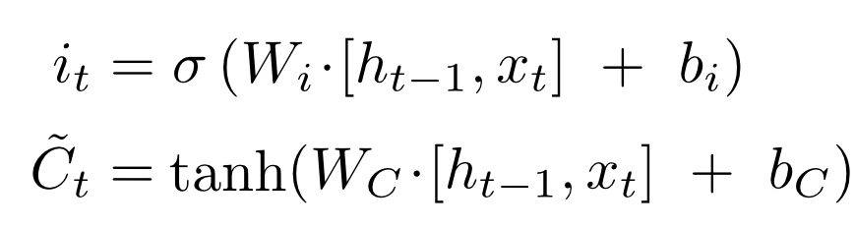
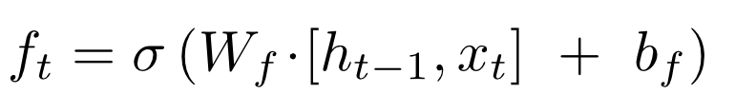
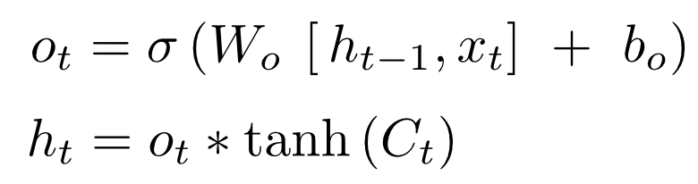
Approach 2 : CNN + LSTM Sequence Model
LSTM has 3 gates which decides which information to remember and forget.
Input gate Decides which input value should be used to alter the memory.
Forget gate - It is used to determine what information to throw away from the cell state.
Output gate Block input and memory are used to decide the output

Slide 14
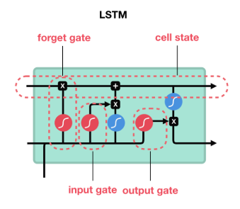
CNN + LSTM Sequence Architecture

Slide 15
Technical Architecture and Design ( Open Source)
Capsule Network (2D CNN):

Slide 16
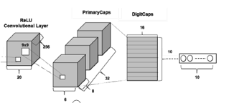
Approach 3: Capsule Networks Model
This model can achieve 97.5+% accuracy and is one of the top benchmark results
By using pooling operations, CNNs lose spatial information between objects, resulting in incorrect classification results.
A CapsNet is therefore designed to maintain spatial relationships using a robust and reliable algorithm called "dynamic routing by agreement" rather than implementing pooling operations.

Slide 17
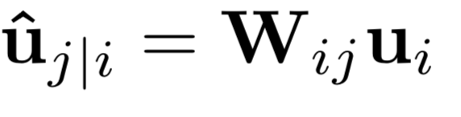
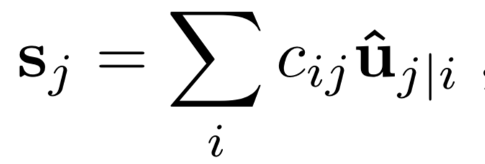
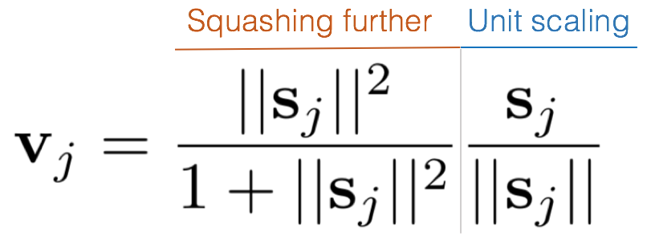
Approach 3: Capsule Networks
Step 1: Receiving an input vector.
u_I
Step 2: Applying “affine transformation” or transformation matrix encoding spatial relationships.
Step 3: Applying weighted sum by the C weights, learned by the routing algorithm.
Step 4: Squashing it to 0–1 with the nonlinear “squashing” activation function
The newly vector will then be sent onwards to further layers.

Slide 18
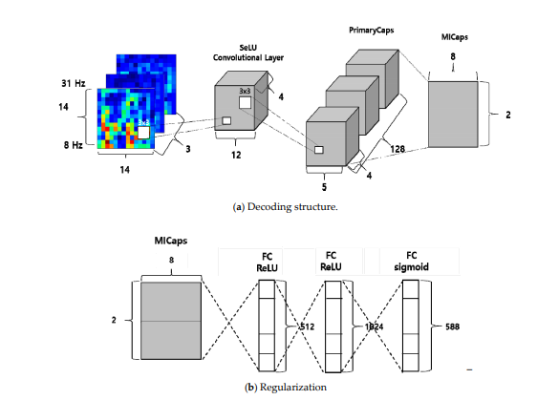
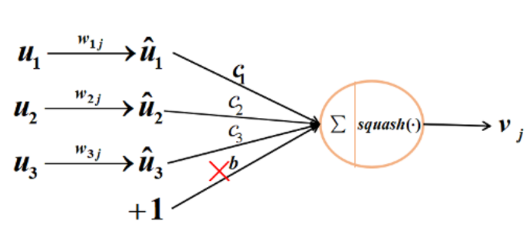
Capsule Networks

Slide 19
Implementation
Implementation of the above design shall use the below packages:
Py-Torch (Deep Learning Modelling)
MNE (Filter Band implementations for EEG)
Magnetoencephalography (MEG) and Electroencephalography (EEG) in python
Python (All of the above code and any supplementary packages such as Matplotlib, Scikit-Learn)

Slide 20
Experimental Results
Algorithm | Accuracy
CNN(1D) | 87.7
CNN(1D)+LSTM | 96.74
CNN(1D)+LSTM - K Fold | 87.758
Capsule Network | 97.58

Slide 21
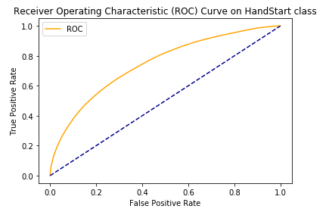
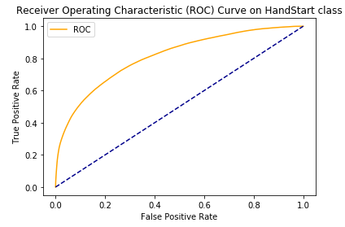
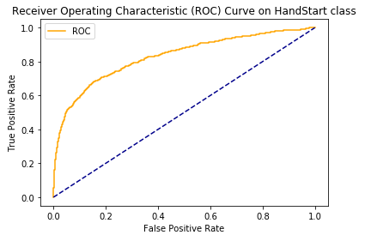
Open Source Data Experimental Results
Base CNN
CNN + LSTM
CNN + Capsnet

Slide 22
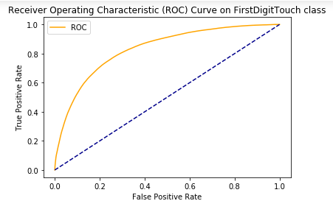
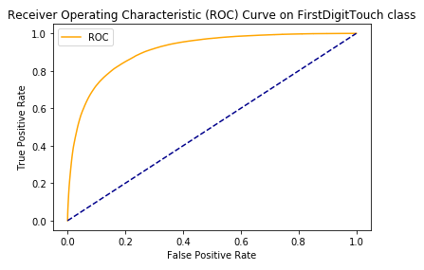
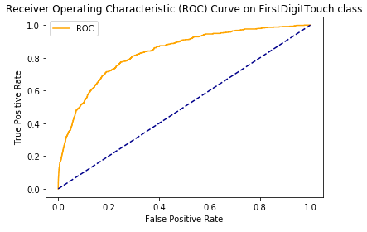
Open Source Data Experimental Results
Base CNN
CNN + LSTM
CNN + Capsnet

Slide 23
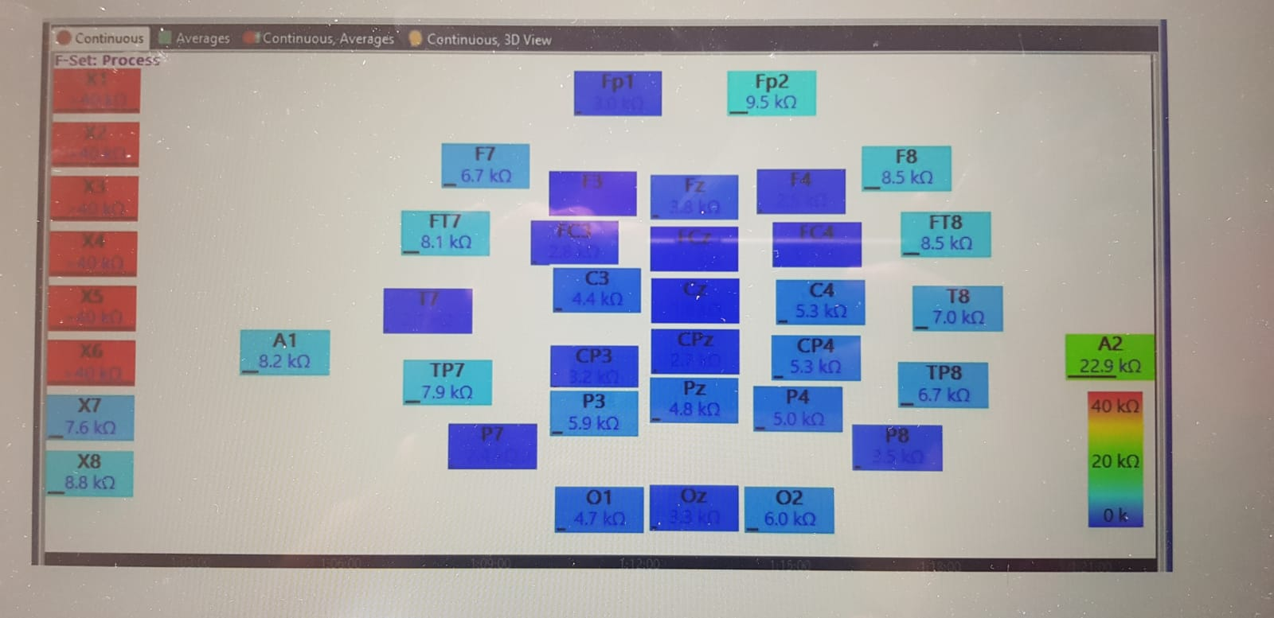
Electrodes (A*)
Quik-cap with 40 electrodes to record EEG Signals
Placed on scalp of ALS affected subject
Reference of A1 and A2 placed at left and right ear lobe respectively
Impedance of each channel are kept below 10 kΩ
Subjects instructed to imagine left, right hand movement
EEG signals collected and filtered (4 to 40 Hz) before passing it to the model.
Figure 3: Impedances of electrodes on ALS patient’s scalp

Slide 24
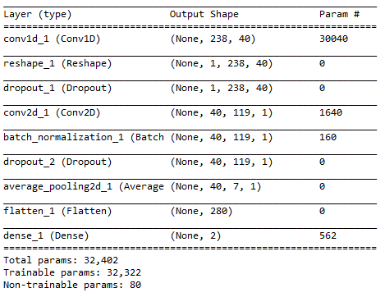
Technical Architecture and Design ( A Star)
Modelling

Slide 25
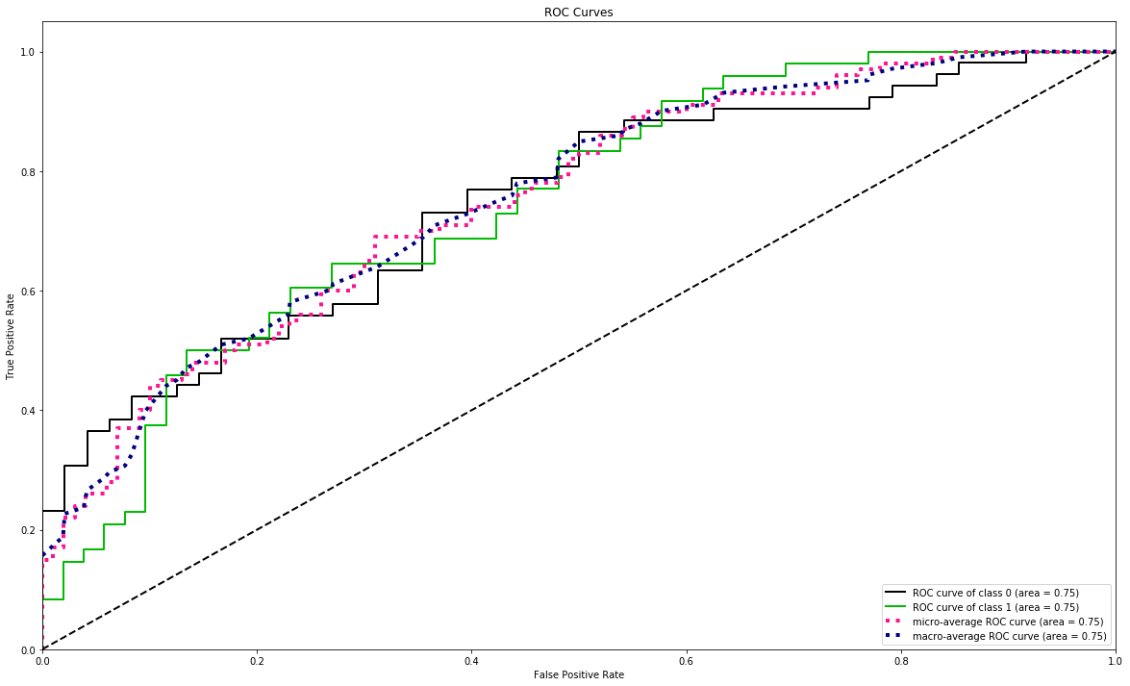
A*STAR Dataset – Training ROC Curves
Area under ROC curve is 0.75 for RIGHT Motor Imagery and IDLE class

Slide 26
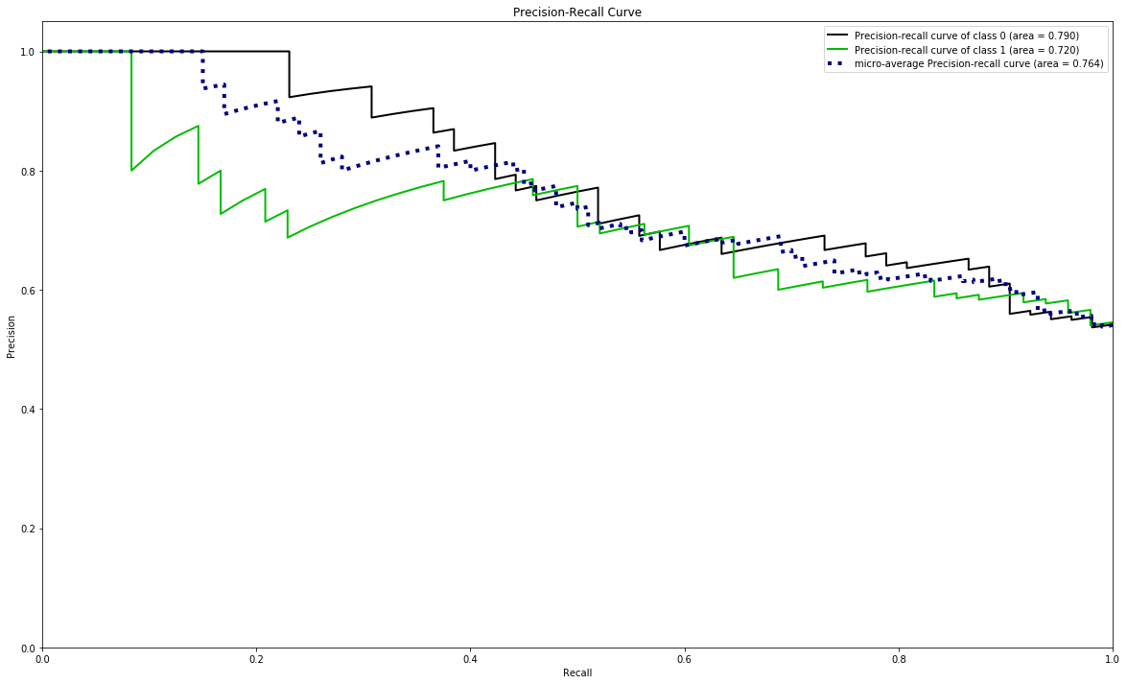
A*STAR Dataset – Training Precision-Recall Curve
Area under Precision-Recall curve is 0.790 for RIGHT Motor Imagery class
Area under Precision-Recall curve is 0.720 for IDLE class

Slide 27
A*STAR Dataset Test Precision Recall Values
 | Precision | Recall | f1-score | support
IDLE | 0.40 | 0.34 | 0.36 | 405
RIGHT_HAND | 0.43 | 0.49 | 0.46 | 406
Micro Avg | 0.41 | 0.41 | 0.41 | 811
Macro Avg | 0.41 | 0.41 | 0.41 | 811
Weighted Avg | 0.41 | 0.41 | 0.41 | 811

Slide 28
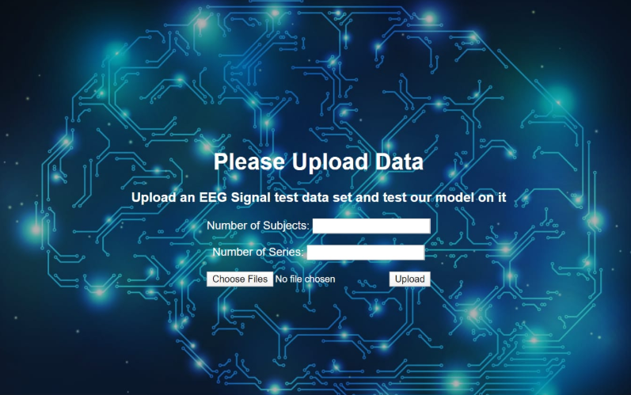
App Interface for Users

Slide 29
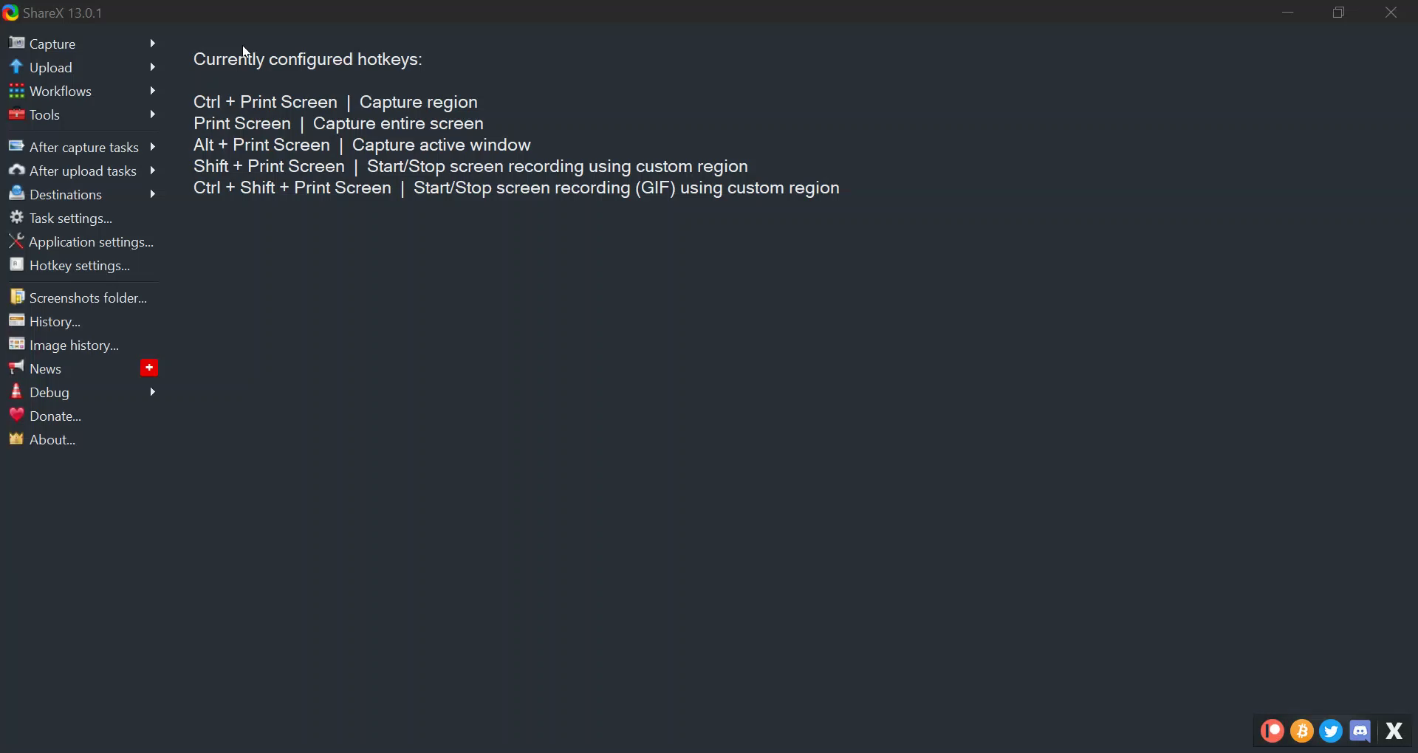
Demo App Interface

Slide 30
Future Work
Same approach can be used on other datasets to prove the effectiveness and reusability
Model rebuilt on newer frameworks and able to train quicker with more resources ( Parallel GPU Training / Multi-GPU Training)
Much Simpler model compared to the competition winning ensemble model (98.1%)
On the downside, Capsule network is quite big and hence takes time to train. Can try to simplify or make it much efficient
If model is accurate, BCI can be extended to patients affected by seizures and epilepsy
Other use cases such as Emotion recognition

Slide 31
Related Work – Appendix – Results of various Algorithms
For A-Star Dataset,
M. Arvaneh, C. Guan, K. K. Ang, and C. Quek, “EEG Data Space Adaptation to Reduce Intersession Non-stationarity in Brain-Computer Interface, Neural Computation, Vol. 25, No. 8, pp. 2146-71, August 2013.
M. Arvaneh, C. Guan, K. K. Ang, and C. Quek, “Optimizing Spatial Filters by Minimizing Within-class Dissimilarities in EEG-based BCI”, IEEE Transactions on Neural Networks and Learning Systems, vol. 24, no. 4, pp. 610-619, April 2013.
For Open Source Dataset,
Comparison of Algorithms – Logistic Regression with Band-Pass Filter Bank
Comparison of Algorithms Algorithms – Logistic Regression with Low-Pass Filter Bank
Comparison of Algorithms Algorithms – Normalization and a Convolutional Neural Network

Slide 32
Thanks
References:
https://www.nature.com/articles/sdata201447
https://www.kaggle.com/c/grasp-and-lift-eeg-detection
https://github.com/alexandrebarachant/Grasp-and-lift-EEG-challenge
https://www.researchgate.net/publication/303363213_Pushing_the_limits_of_BCI_accuracy_Winning_solution_of_the_Grasp_Lift_EEG_challenge
https://ieeexplore.ieee.org/document/7425963
https://ieeexplore.ieee.org/document/7844566
https://ieeexplore-ieee-org.libproxy1.nus.edu.sg/stamp/stamp.jsp?tp=&arnumber=7425963
https://jimmysuen.github.io/
https://github.com/hjweide/kaggle-grasp-and-lift
https://pechyonkin.me/capsules-1/
https://pechyonkin.me/capsules-4/
Motor Imagery EEG Classification Using Capsule Networks - Kwon-Woo Ha and Jin-Woo Jeong

